Slide 1
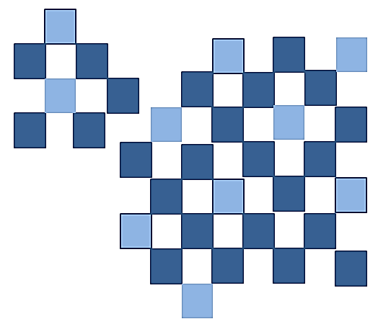
Information Technology
Essentials
2nd
Edition
CHAPTER 1
INFORMATION TECHNOLOGY AND THE INTERNET
Prepared by: Arlene N. Baratang

Slide 2
OBJECTIVES
Define information technology.
Discuss the five components of an information system.
Differentiate between systems software and application software.
Identify the different data.
Define computer connectivity, wireless revolution and the Internet.

Slide 3
What is IT?
Information technology is the use of hardware, software, services, and supporting infrastructure to manage and deliver information using voice, data, and video.
IT refers also to:
Management Information System (MIS)
Information System (IS)
Information and Communication Technology (ICT)

Slide 4
Network Services
Network services refer to the equipment, software, and services necessary to transmit voice, data, or video.

Slide 5
ICT Covers …
….. any medium to record information, technology for broadcasting information and wireless mobile telecommunications.
The term Information Technology was coined by Jim Domsic of Michigan in November 1981. He created this term to update the phrase “data processing” (Patil, 2009).

Slide 6
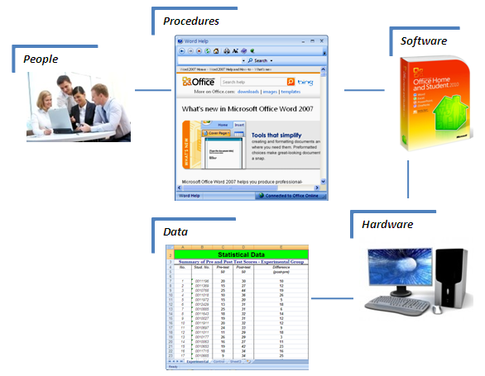
Components of IS

Slide 7
Components of IS….
People. It refers to the end users who use computers to make themselves more productive.
Procedures. These are the rules and guidelines for users to follow when using software, hardware and data. Procedures can be in a form of written manuals by software and hardware manufacturers for their products.
Software. It is another name for programs. Programs are instructions that tell the computer how to process data.

Slide 8
Kinds of Software
System software enables the application software interact with the computer hardware and helps the computer manage its own internal resources.
Application software can be described as end user software.

Slide 9
Hardware
It refers to the equipment that processes data to become information. Devices like keyboard, monitor, mouse, system unit and others are hardware which is controlled by software.

Slide 10
Types of Computers
Supercomputers. These are the most powerful type of computer. Example of supercomputer is IBM’s Blue Gene which is one of the fastest computers in the world.
Mainframe computers. These are capable of great processing speeds and data storage. Insurance companies use mainframes to process information about millions of policy holders.

Slide 11
Types of computers…
Minicomputers or midrange computers. The capabilities of minicomputers are between mainframes and personal computers. Most “minis” are designed to handle multiple terminals and can serve the input and output needs of hundred users at a time.
Microcomputers. The least powerful but the most widely used type computer. Six types of microcomputers are: desktop, media center, notebook, netbook, tablet PC, and handheld computers.

Slide 12
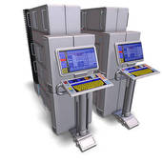
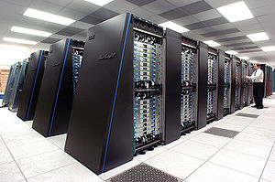
Types of computers…
Supercomputer
Mainframe

Slide 13
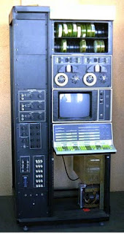
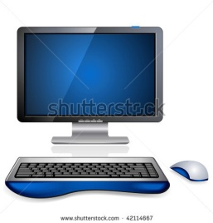
Types of computers…
Minicomputer
Microcomputer

Slide 14
Microcomputer Hardware
System unit. It serves as container that houses most of the electronic components of the computer system.
Input/Output. Input devices translate human readable data and programs into a form that the computer can process. Mouse and keyboard are the most commonly used input devices. Output devices translates the processed data from the computer into a human readable format. The most common output devices are monitors and printers.

Slide 15
Microcomputer Hardware
Secondary storage. It holds data and programs even after electric power of the computer system was turned off. Types of secondary storage are hard disks, solid-state drives (SSDs) and optical disks like CDs and DVDs.
Communication device. The most commonly used communication device is modem which modifies computer output into a form that can be transmitted across telephone lines. It can also transform telephone communications into a form that can be processed by computer.

Slide 16
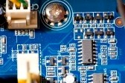
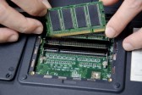

Microcomputer Hardware
RAM for laptop
Computer Motherboard
Wireless Modem

Slide 17
Data
Data are the raw and unprocessed facts like text, numbers, images and sounds. Processed data are also called information. The four common types of files are:
Document files. These are files generated by word processors like memos, letters, and reports.
Worksheet files. These are files created using electronic spreadsheets to analyze data like budgets and sales income.

Slide 18
Data …
Database files. Database management program create database files that contain structured and organized data. Student database file might contain students’ names, course, year level and other related information.
Presentation files. These files like audience handouts, speaker notes and electronic slides are generated by presentation graphics programs.

Slide 19
Four Common Types of Files
Document files. These are files generated by word processors like memos, letters, and reports. Four
Worksheet files. These are files created using electronic spreadsheets to analyze data like budgets and sales income.
Database files. Database management program create database files that contain structured and organized data. Student database file might contain students’ names, course, year level and other related information.
Presentation files. These files like audience handouts, speaker notes and electronic slides are generated by presentation graphics programs.

Slide 20
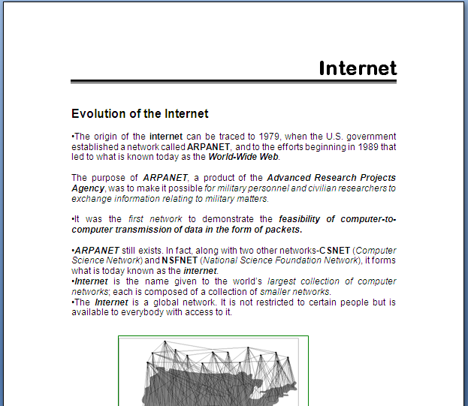
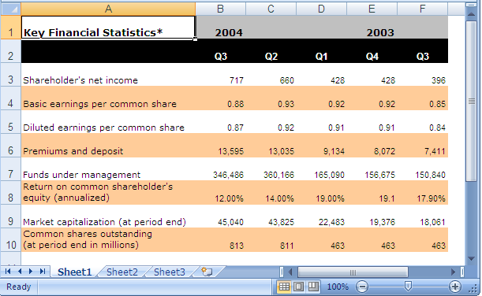
Document file
Four common types of files..
Worksheet file

Slide 21
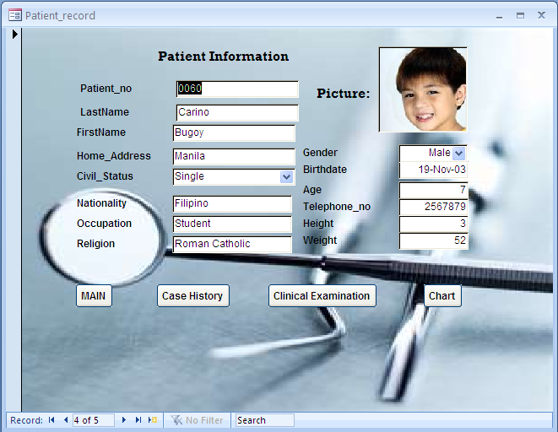
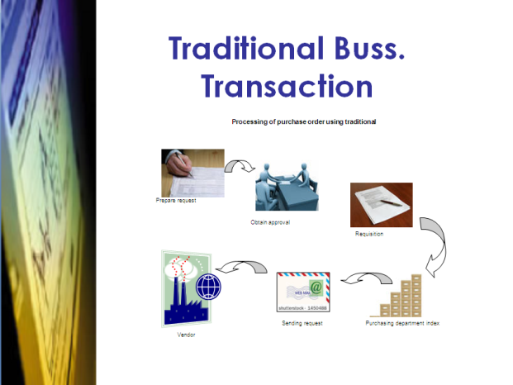
Four common types of files..
Database file
Presentation file

Slide 22

Connectivity
Connectivity is the capability of microcomputer to share information with other computers.
  The widespread use of mobile or wireless communication devices is the most dramatic change in connectivity for the past five years.

Slide 23
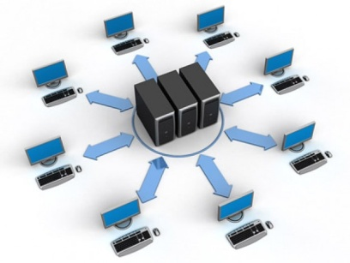
Network
A network is a communication system that connects two or more computers. The Internet is the largest network in the world that connects people with millions of other people and organizations all over the world. The Web provides a multimedia interface to resources accessible on the Internet.
Computer network

Slide 24
Careers in IT
Career | Role
Webmaster | Develops and maintains Web sites and Web resources.
Technical writer | Prepares instruction manuals, technical reports and documents.
Network administrator | Creates and maintains computer networks.
Database administrator | Uses database management software for efficient organization and access of data.
Systems analyst | Plans, designs, and maintains information systems.
Programmer | Creates, tests, and troubleshoots computer programs.

Slide 25
Summary
Information technology or IT is the use of hardware, software, services and supporting infrastructure to manage and deliver information. Network services refer to the equipment, software and services to transmit voice, data or video. IT may be also referred to as Management Information System (MIS), Information System (IS) and Information and Communication Technology (ICT). The term information technology was coined by Jim Domsic in November 1981 replacing the older term “data processing”.
Information system is a collection of people, procedure, software, hardware and data. The two major kinds of software are system software and application software. Hardware refers to the equipment that transforms data into information. Types of computer are supercomputers, mainframe, minicomputers and microcomputers. Microcomputer hardware is composed of a system unit, input devices, output devices, secondary storage and communication device.

Slide 26
Summary…
Data are raw texts, numbers, images and sounds that are unprocessed. Information are processed data. The four common types of files are document, worksheet, database and presentation files.
Connectivity is the capability of microcomputer to share information with other computers. Wireless communication using mobile devices is the beginning of wireless revolution. The Internet is the largest network in the world connecting millions of people and organizations.
Some careers in IT are Webmaster, technical writer, network administrator, database administrator, systems analyst and programmer.

Slide 27
Comprehension Check
What are the five components of information system?
What is connectivity?
Compare system software from application software.
Describe the four common types of files.
Discuss some applications of IT.

Slide 28
Applying Technology
Digital Video Editing
  Your computer can capture video using digital camcorder. Here are the steps to capture video from a digital camcorder using Windows Vista:
  Connect your digital camcorder to your computer then turn it on.
  Select Import Video.
  Type a filename and select a location to save imported video.
  Select the portion of the video to import or you can import the entire video.
  Preview the video as it is captured from your camera to the file specified.
  (cont. on next slide)

Slide 29
You can edit your video using Windows Movie Maker that divides your video into clips that make up your movie. Below are steps to make your movie by arranging the clips and adding special effects.
Select and drag move clips from the Contents Pane and arrange them in the Storyboard.
You can add sounds, transitions, titles on screen and effects using option on Task Pane.
Use the Preview Monitor to preview your movie.

Slide 30
REFERENCES
O’Leary, Timothy J. and O’Leary Linda I. “Computing Essentials 2011 Complete: Making IT Work for You”. McGraw-Hill International Edition: 2011.
ND Century Code 54.59.01.
Excerpt from 'Information Technology in Veterinary Science' (2009), New India Publishing Agency, New Delhi. ISBN 978-81-908512-4-4

